Slide 1
Computer Graphics
Classes A and E – Year 2017/2018

Slide 2
Instructor Information
Anny Yuniarti, S.Kom, M.Comp.Sc
S1: Teknik Informatika ITS (1999-2003)
S2: The University of Western Australia (2006-2008)
Email: anny@if.its.ac.id
Office: Room IF 229 / DPTSI (3rd Floor, Research Centre ITS)
Currently is also a Head of IS Development in DPTSI ITS

Slide 3
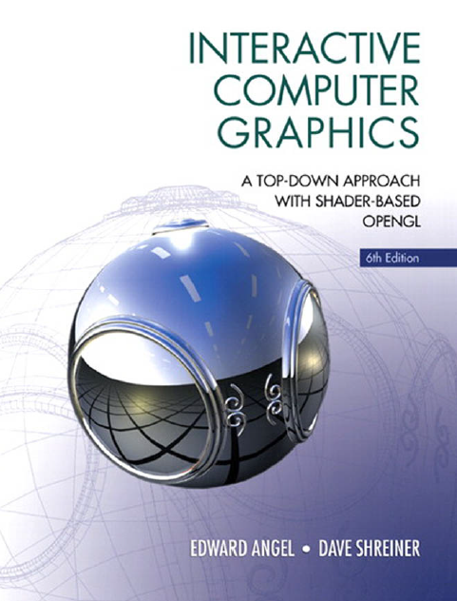
Course Information
Grafika kelas A dan E
Jadwal: Selasa 12.30 – 15.00 (A), Rabu 12.30 – 15.00 (E)
Course Materials: Google Classroom
Class Coordinators: …?
Q&A and Discussions: Google Classroom
Mailing list: Google classroom
Textbook: Interactive Computer Graphics 6Ed
Notes:
Choose class coordinators and the medium of online discussion.

Slide 4
Questionnaire

Slide 5
Task 1
Group Discussion

Slide 6
Discuss and answer the following questions
What do you think Computer Graphics is?
What products use Computer Graphics?
Software products or other IT related products
What is the difference between Computer Graphics, Computer Vision and Digital Image Processing?
All those three subjects are in our curriculum
Notes:
Time Limit: 5 minutes

Slide 7
End of Task 1
Group Discussion

Slide 8
Course Information
(continued)

Slide 9
Course Objectives
This unit teaches the fundamentals of computer-generated three-dimensional graphics and animation for applications including creating interactive virtual environments.
The unit introduces the virtual image formation process using a synthetic camera model.
The OpenGL API is introduced for writing interactive graphics programs.
Fundamental techniques are emphasised, such as using the homogeneous coordinate system for affine transformations.
The unit then covers lighting and shading models, as well as the use of GLSL programmable shaders.
The practical component of the unit involves developing a realistic three-dimensional image application using the core concepts covered in the unit.

Slide 10
Grading Information
Assignments: 30%
Mid-Exam: 30%
Final Project: 40%
Individually
Individually
A group of 3 – 4
students

Slide 11
Topics
Week 1 - 8
Week 9 - 16
Introduction and Image Formation
Models and Architectures
Programming in OpenGL 1-6
Input and Interaction
Working with Callbacks
Representation
Transformation
Computer Viewing
ETS
Shading I – II
Shading in OpenGL
Texture Mapping
Texture Mapping in OpenGL
Subdivision Surfaces
Animation Fundamentals
Skinning
Hierarchical Modeling
FP Demo

Slide 12
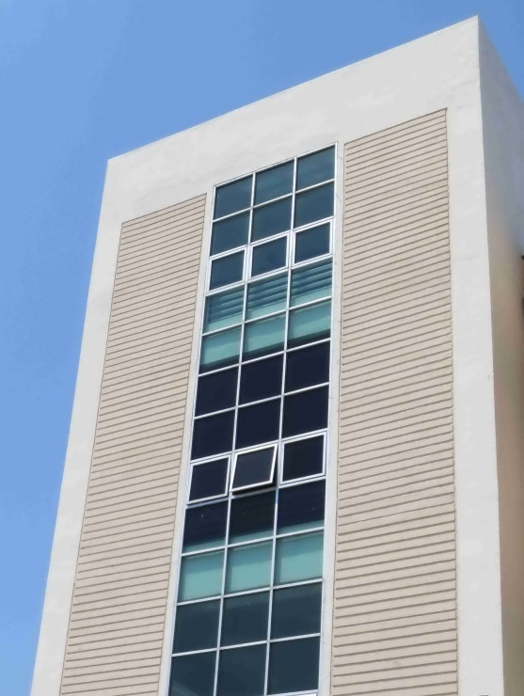
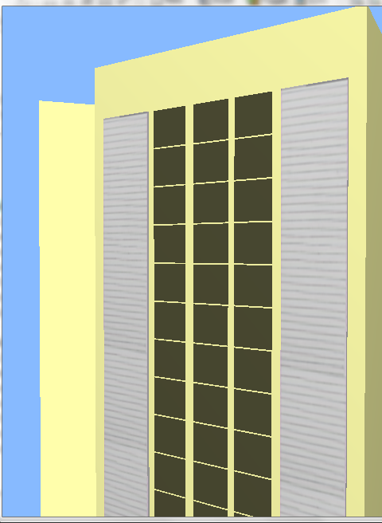
Some Works by Previous Students

Slide 13
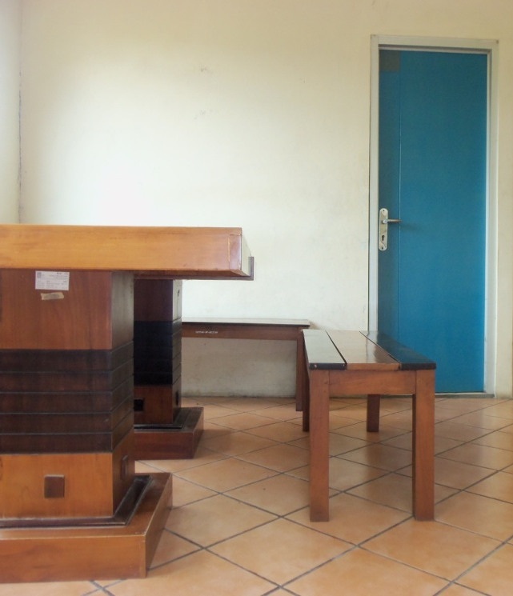
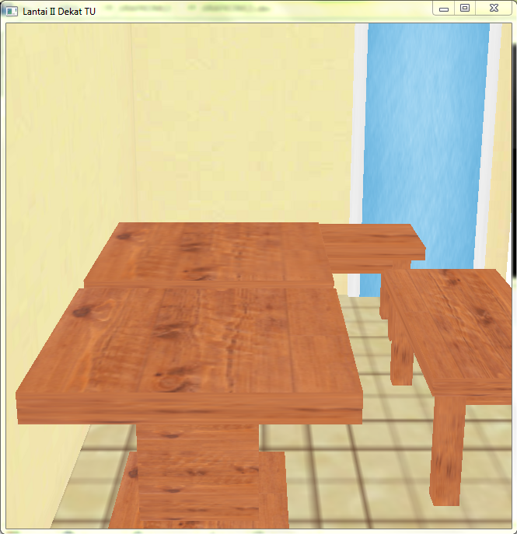
Some Works by Previous Students

Slide 14
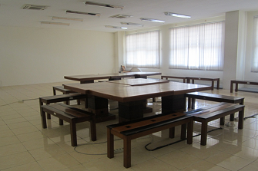
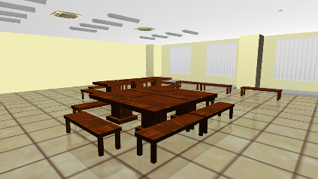
Some Works by Previous Students

Slide 15
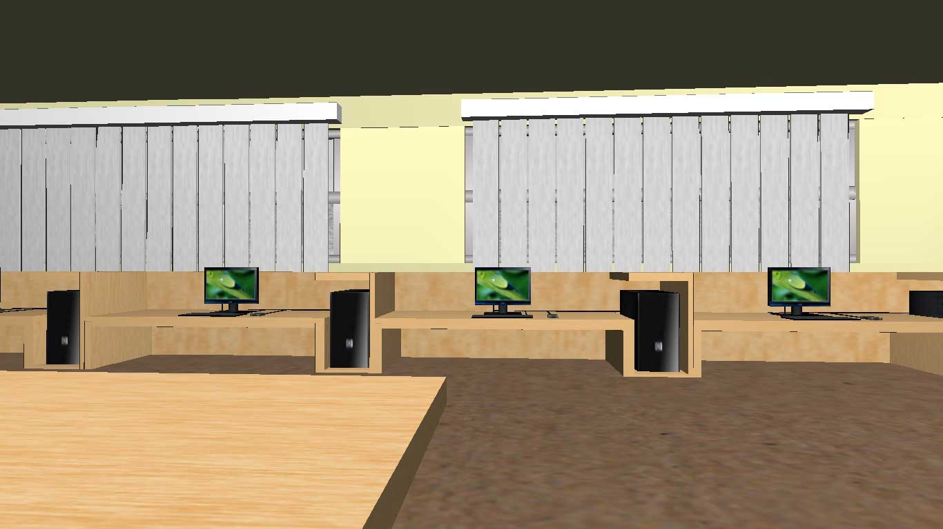
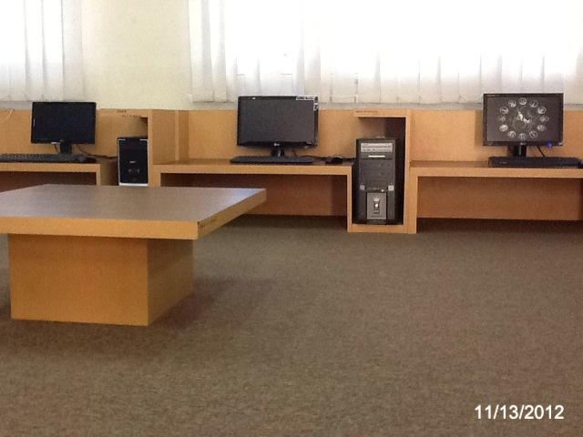
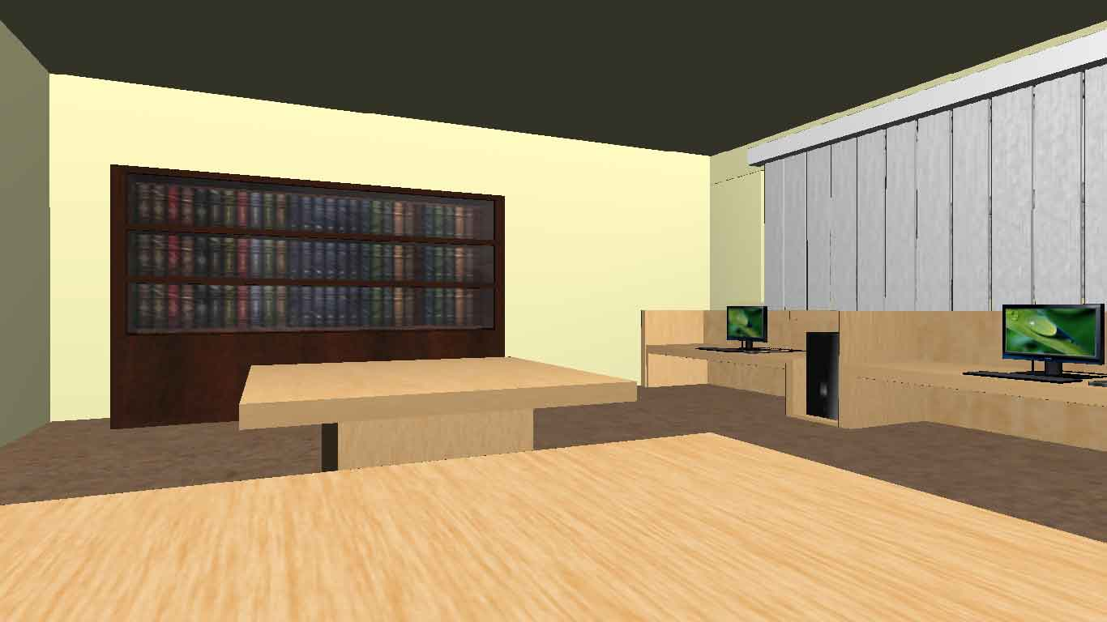
Some Works by Previous Students

Slide 16
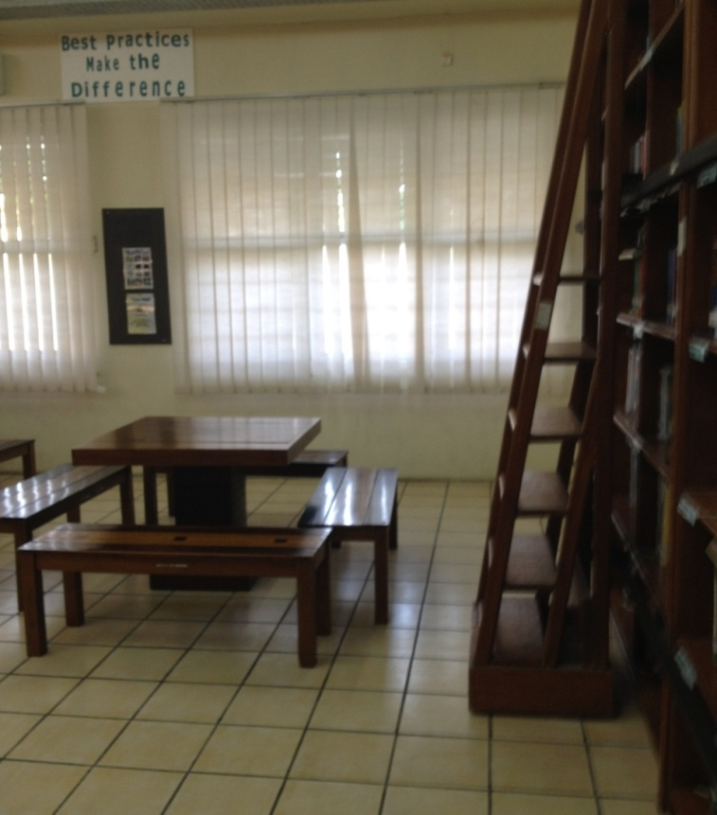
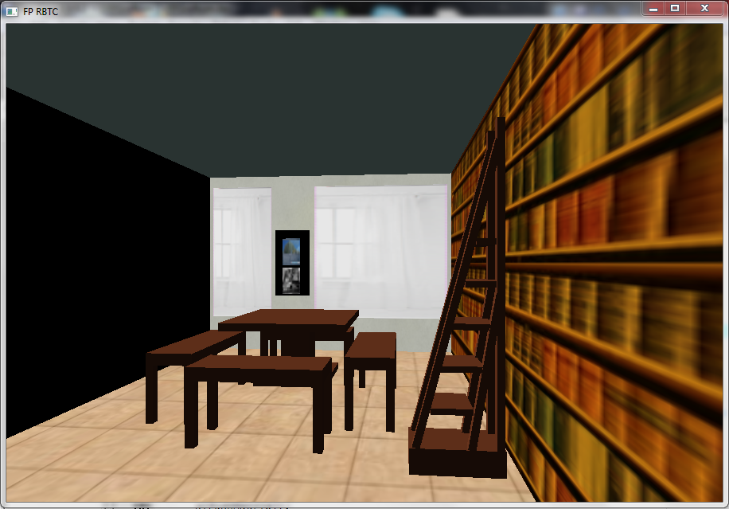
Some Works by Previous Students

Slide 17
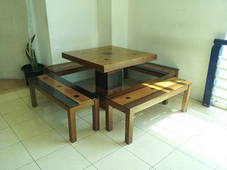
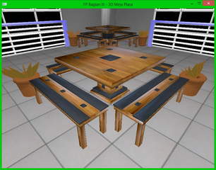
Some Works by Previous Students

Slide 18
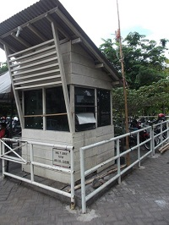
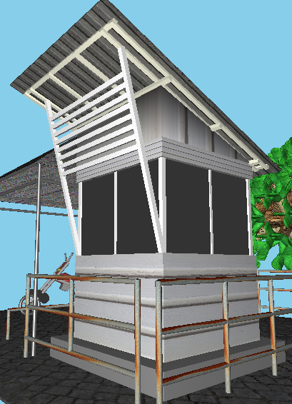
Some Works by Previous Students

Slide 19
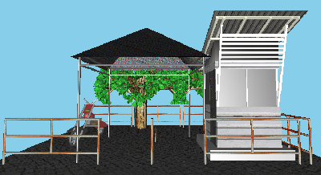
Week 1: Introduction and Image Formation

Slide 20
Objectives
Fundamental imaging notions
Physical basis for image formation
Light
Color
Perception
Synthetic camera model
Other models

Slide 21
Image Formation
In computer graphics, we form images which are generally two dimensional using a process analogous to how images are formed by physical imaging systems
Cameras
Microscopes
Telescopes
Human visual system

Slide 22
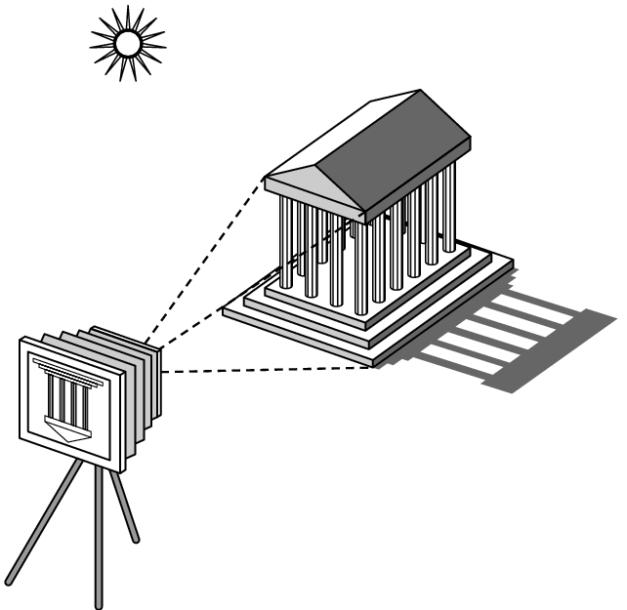
Elements of Image Formation
Objects
Viewer
Light source(s)
Attributes that govern how light interacts with the materials in the scene
Note the independence of the objects, the viewer, and the light source(s)

Slide 23
Light
Light is the part of the electromagnetic spectrum that causes a reaction in our visual systems
Generally these are wavelengths in the range of about 350-750 nm (nanometers)
Long wavelengths appear as reds and short wavelengths as blues

Slide 24
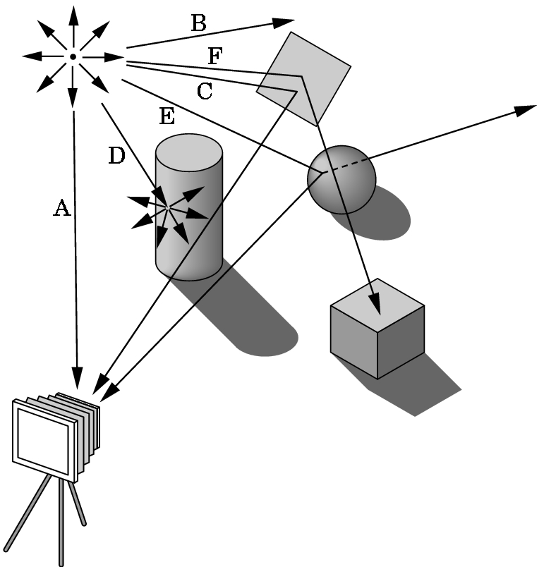
Ray Tracing and Geometric Optics
One way to form an image is to
follow rays of light from a
point source finding which
rays enter the lens of the
camera. However, each
ray of light may have
multiple interactions with objects
before being absorbed or going to infinity.

Slide 25
Luminance and Color Images
Luminance Image
Monochromatic
Values are gray levels
Analogous to working with black and white film or television
Color Image
Has perceptional attributes of hue, saturation, and lightness
Do we have to match every frequency in visible spectrum? No!

Slide 26
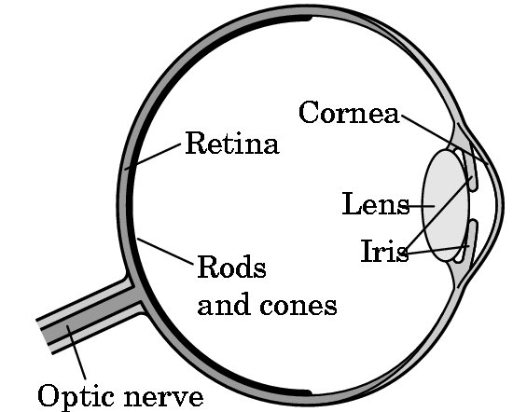
Three-Color Theory
Human visual system has two types of sensors
Rods: monochromatic, night vision
Cones
Color sensitive
Three types of cones
Only three values (the tristimulus
values) are sent to the brain
Need only match these three values
Need only three primary colors

Slide 27
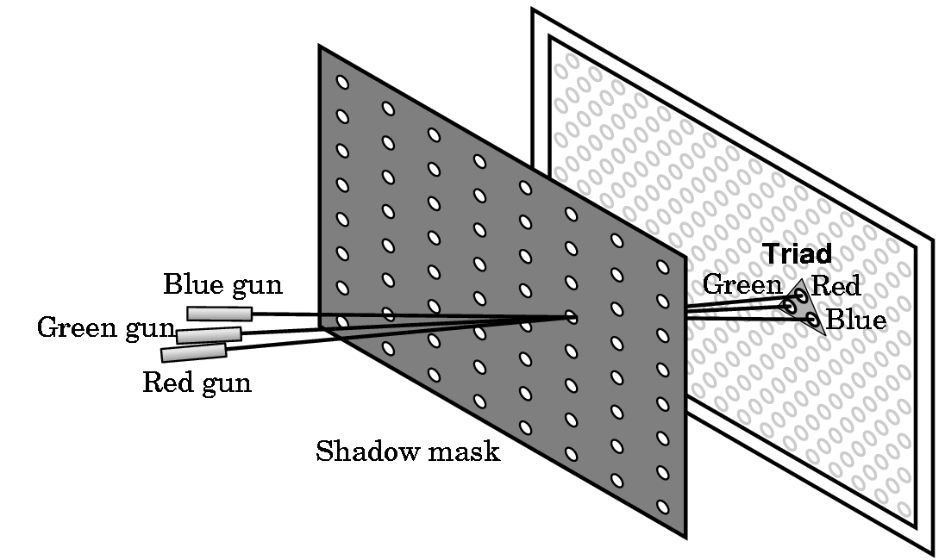
Shadow Mask CRT

Slide 28
Additive and Subtractive Color
Additive color
Form a color by adding amounts of three primaries
CRTs, projection systems, positive film
Primaries are Red (R), Green (G), Blue (B)
Subtractive color
Form a color by filtering white light with cyan (C), Magenta (M), and Yellow (Y) filters
Light-material interactions
Printing
Negative film

Slide 29
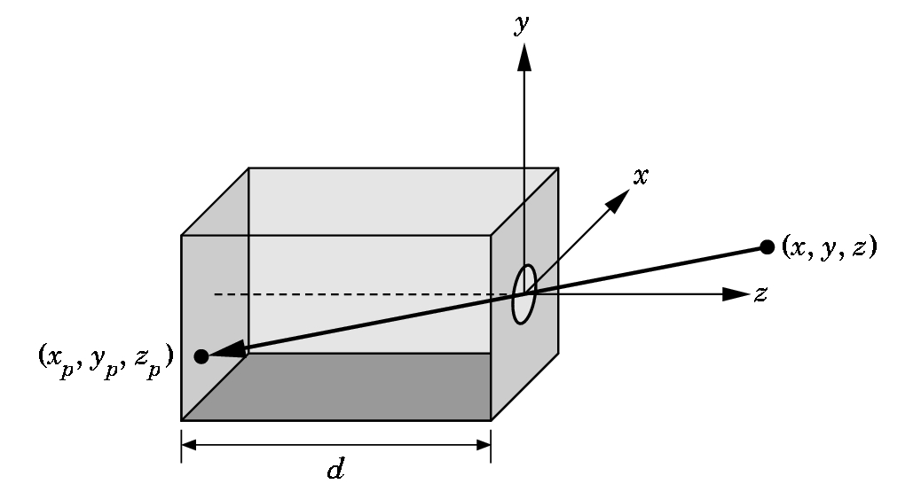
Pinhole Camera
Use trigonometry to find projection of point at (x,y,z)
x_{p}= -x/z/d
y_{p}= -y/z/d
z_{p}= d
These are equations of simple perspective

Slide 30
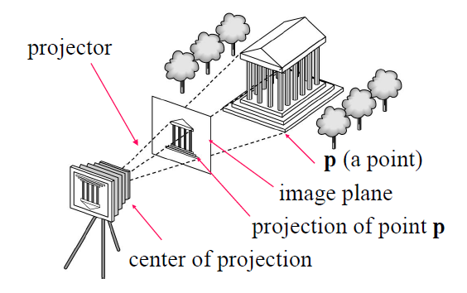
Synthetic Camera Model

Slide 31
Advantages
Separation of objects, viewer, light sources
Two-dimensional graphics is a special case of three-dimensional graphics
Leads to simple software API
Specify objects, lights, camera, attributes
Let implementation determine image
Leads to fast hardware implementation

Slide 32
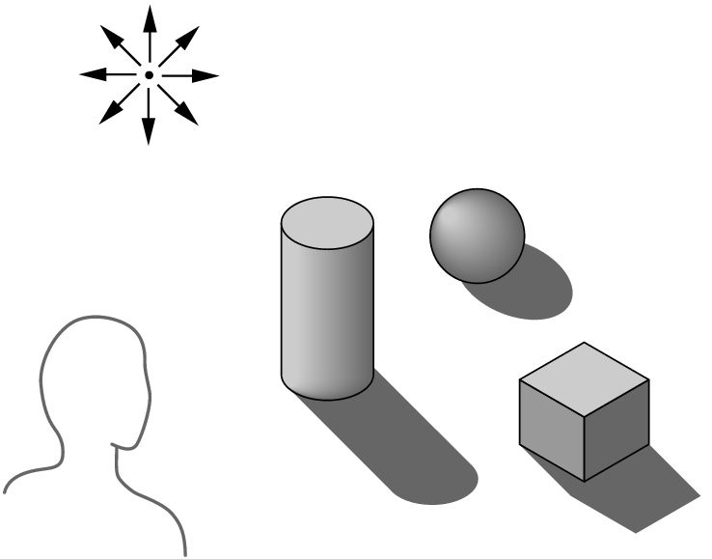
Global vs Local Lighting
Cannot compute color or shade of each object independently
Some objects are blocked from light
Light can reflect from object to object
Some objects might be translucent

Slide 33
Why not ray tracing?
Ray tracing seems more physically based so why don’t we use it to design a graphics system?
Possible and is actually simple for simple objects such as polygons and quadrics with simple point sources
In principle, can produce global lighting effects such as shadows and multiple reflections but ray tracing is slow and not well-suited for interactive applications

Slide 34
Thank you ☺
Any Questions?

Slide 35
Exercise
Explain the synthetic camera model, including:
How does it relate 3D space to 2D images?
How is it relevant to OpenGL?
How does it relate to a pinhole camera?

Slide 36
Week 1: The Programming

Slide 37
We’ll use C++ in this unit
We need an IDE (Code::Blocks or Dev-C++)
http://www.codeblocks.org/
And of course, the graphics library: OpenGL
http://www.opengl.org/
Besides the core library (OpenGL), we need GLUT (freeglut)
http://wiki.codeblocks.org/index.php?title=Using_FreeGlut_with_Code::Blocks

Slide 38
A little Info on Glut32 and FreeGlut
The original Glut32 written by Mark Kilgard was ported over by Nate Robins. And you can get the ported Glut32 Binaries if you want to see it.
http://www.xmission.com/~nate/glut.html
NOTE : The latest version of the Glut32 library is 3.7.6 ( Dated Nov 8, 2001 )
This is the freeglut download links.
http://freeglut.sourceforge.net/index.php#download
in that link you will see the title : Prepackaged Releases and the first link takes you to the binaries to be downloaded on this link
http://www.transmissionzero.co.uk/software/freeglut-devel/
Its in there where you will see the MinGW download package. ( NOTE : Latest Binary release is dated May 11th 2013 known as Martin Payne's Windows binaries. )
Download freeglut 2.8.1‑1 for MinGW --------> freeglut-MinGW-2.8.1-1.mp.zip
This was in reference to Windows and Linux packages according to their website.

Slide 39
A little Info on Glut32 and FreeGlut
When Glut32 was ported over it stopped being updated in 2001.
So some folks decided to recreate it and named it FreeGlut.
The interesting part is freeGlut and Glut32 can be installed just about the same way for Code::Blocks, with the exception that you would not have to edit the two scripts if your installing Glut32.
FreeGlut and Glut32 are a set of functions for use with OpenGL.
It has made graphic software a little easier to code when it comes to programming OpenGL with 3D in mind.
Your task: follow the instructions in the tutorial
http://wiki.codeblocks.org/index.php?title=Using_FreeGlut_with_Code::Blocks

Slide 40
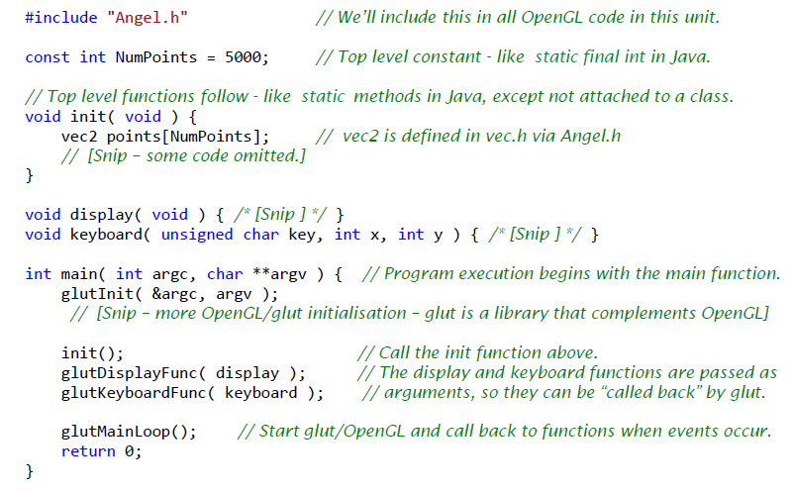
Example1.cpp – program structure

Slide 41
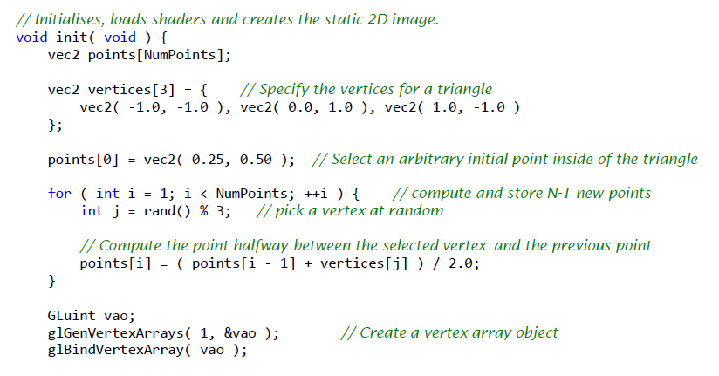
Example1.cpp – init function (1 of 2)

Slide 42
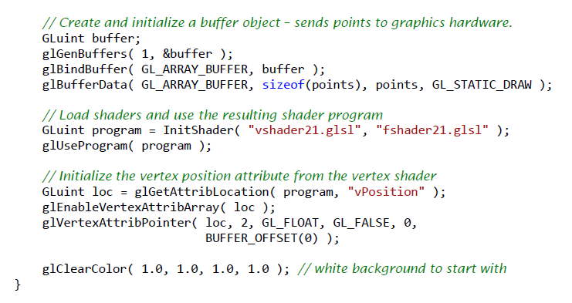
Example1.cpp – init function (2 of 2)

Slide 43
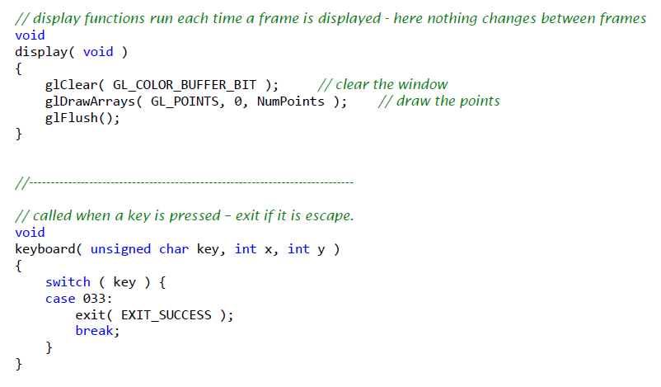
Example1.cpp – display and keyboard

Slide 44
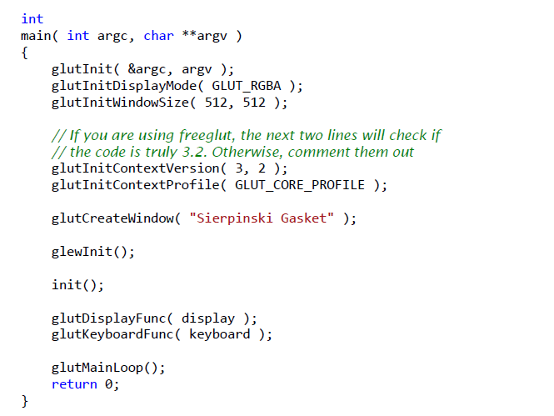
Example1.cpp – main

Slide 45
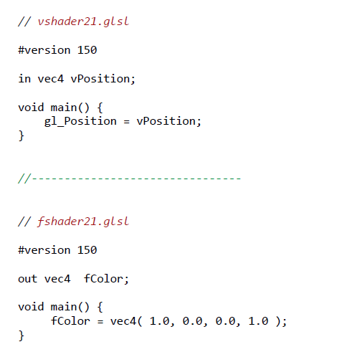
Example1.cpp – GLSL shaders

Slide 46
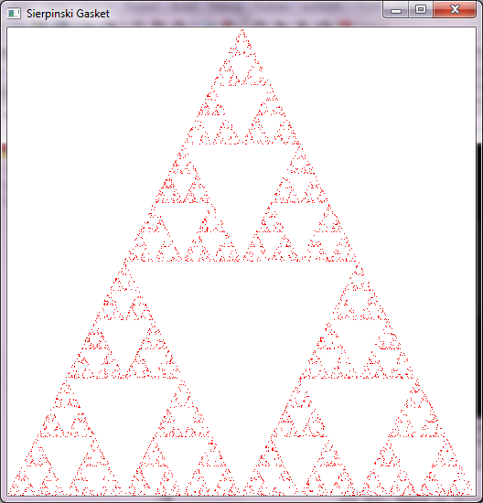

Slide 47
Next Week: Models and Architectures
Also Programming in OpenGL 1: Background
Read the Textbook Ch. 1 (pp 1 – 42)

